Slide 1
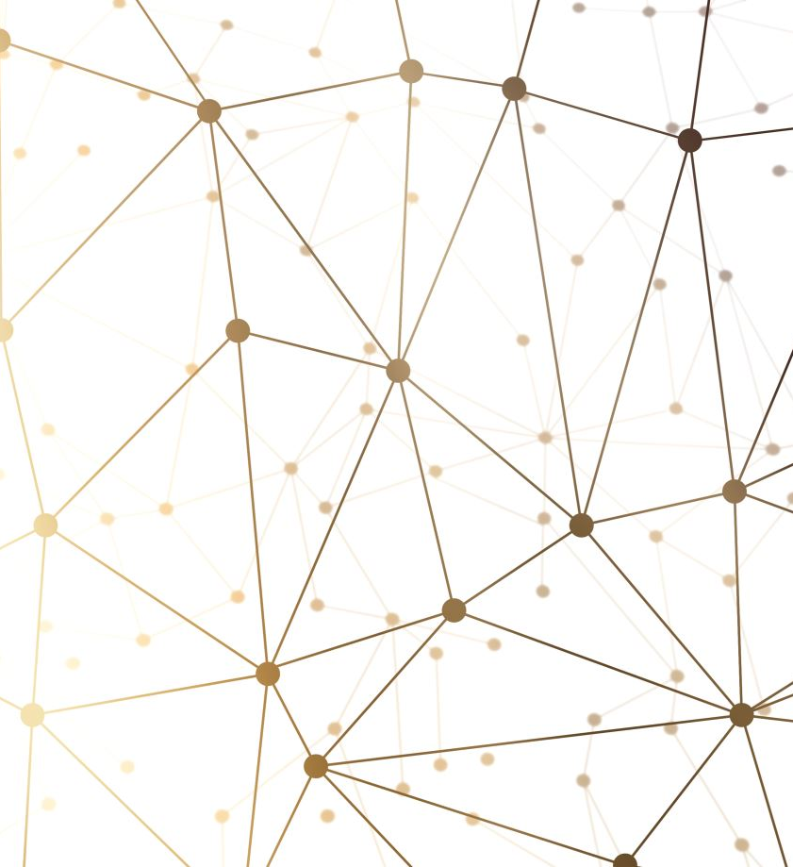
Stem camp overview
Aaron castro zazueta
Nithin sai sunkavalli

Slide 2
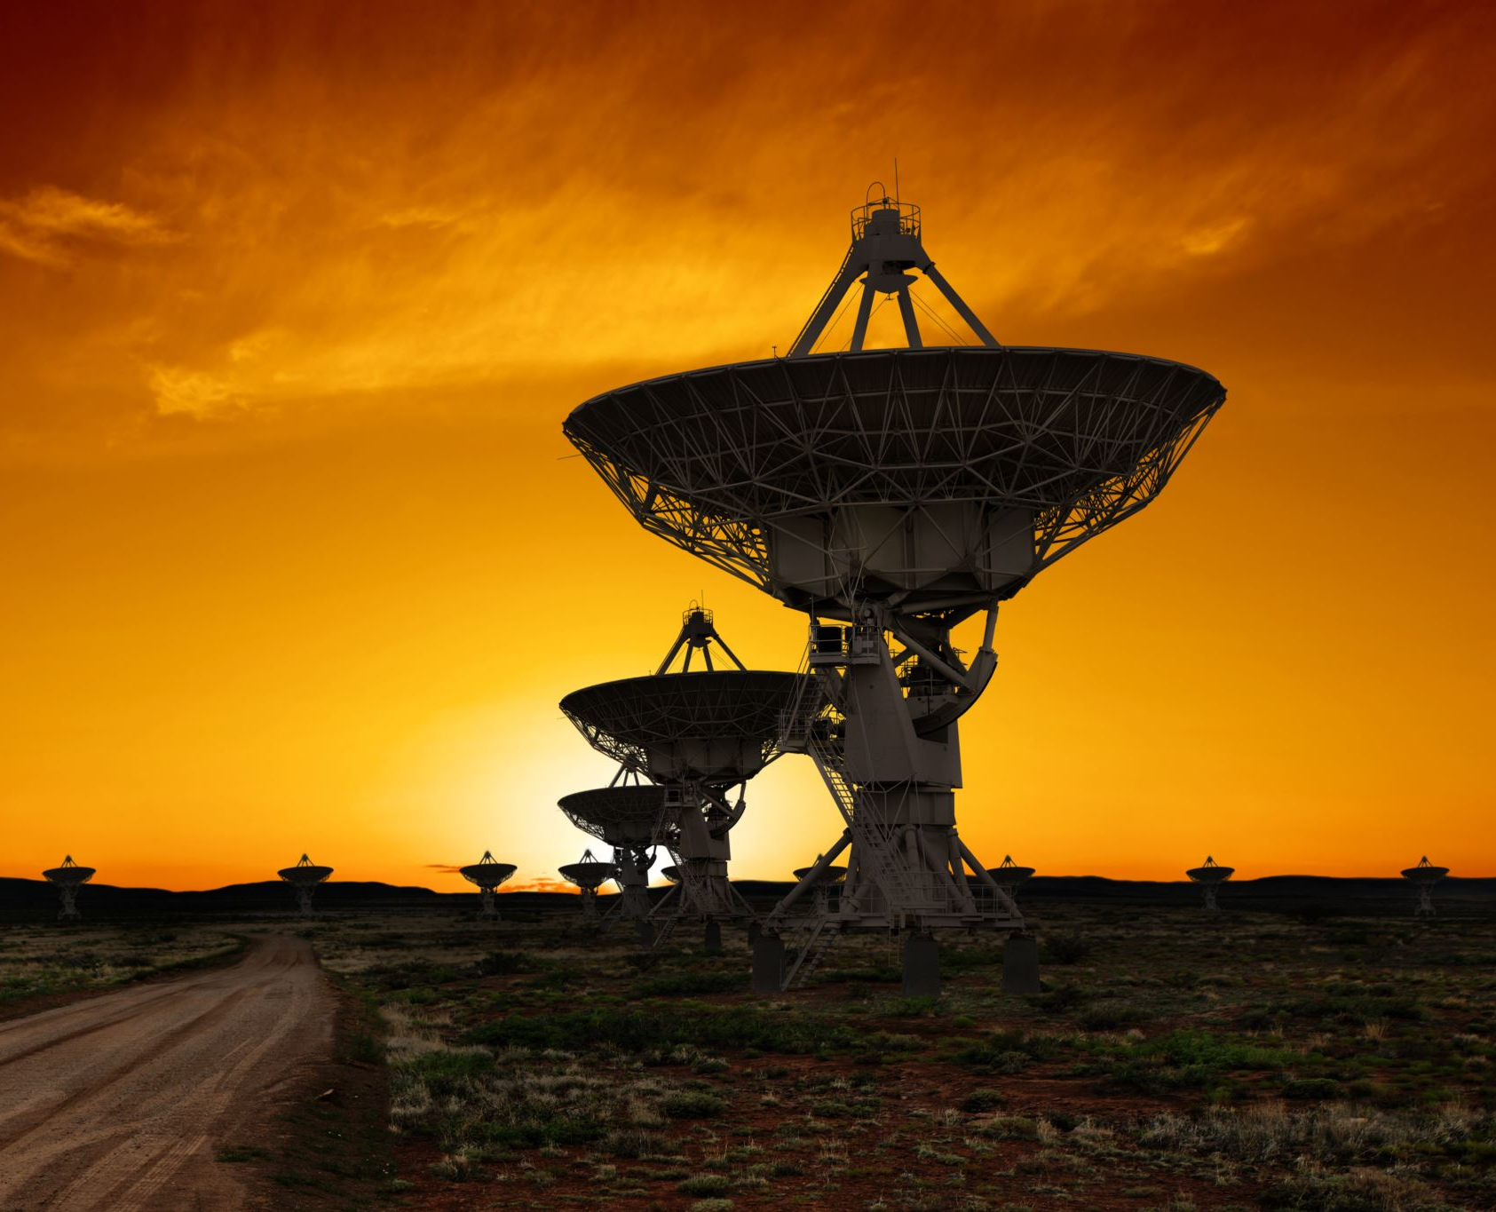
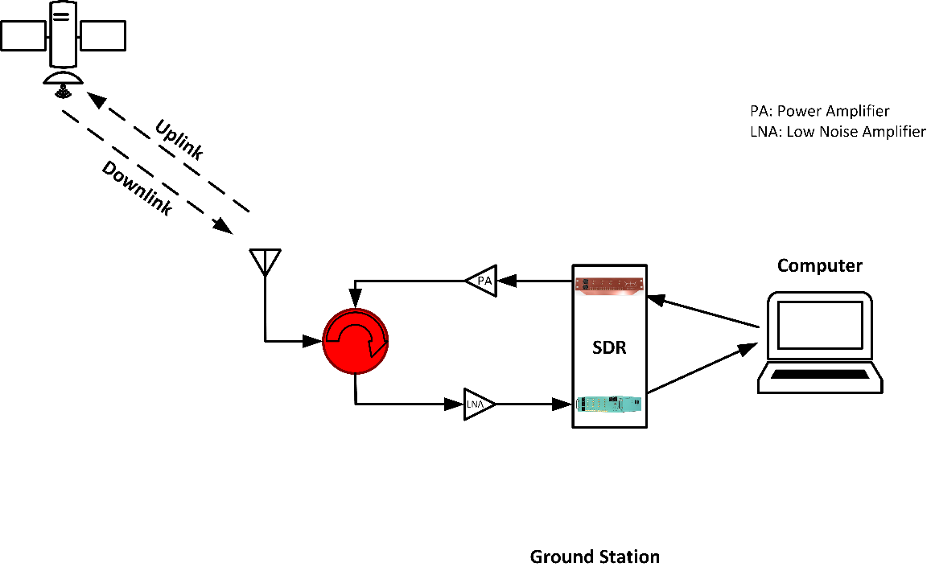
Agenda
In this event you will assemble and work on a Software defined radio receiver for NOAA satellite series as seen below

Slide 3

Along the way, you will learn about these topics:
Basics of a signal (terms like frequency, spectrum, amplitude, interference, etc. )
Transmitters and receivers.
Working of a satellite
SDR equipment
Noise filters
Basic antenna theory

